Slide 1
RWAM INSURANCE ADMINISTRATORS INC.
Plan Member Services For You

Slide 2
REGISTER
Registration on the Plan Member Services website is easy with RWAM Insurance Administrators Inc. With a few simple steps you’ll be ready to take full advantage of your benefits!
eServices
Submit your health and dental claims electronically and stop waiting for your money! With easy electronic claim submission, you get your money faster.
INFORMATION
Finding coverage information and plan details is easy with RWAM’s online Plan Member Services. Claim history, coverage, balances, digital RWAM OneCard and more, are all available online or on the Mobile App!
Did You Know?
RWAM makes it easy for your health care provider to submit insurance claims on your behalf. Your claim can be submitted through the RWAM Provider Claims Service portal, or through TELUS Health, with no fee or upfront cost! Keep your money in your wallet with RWAM eClaims and TELUS Health.

Slide 3
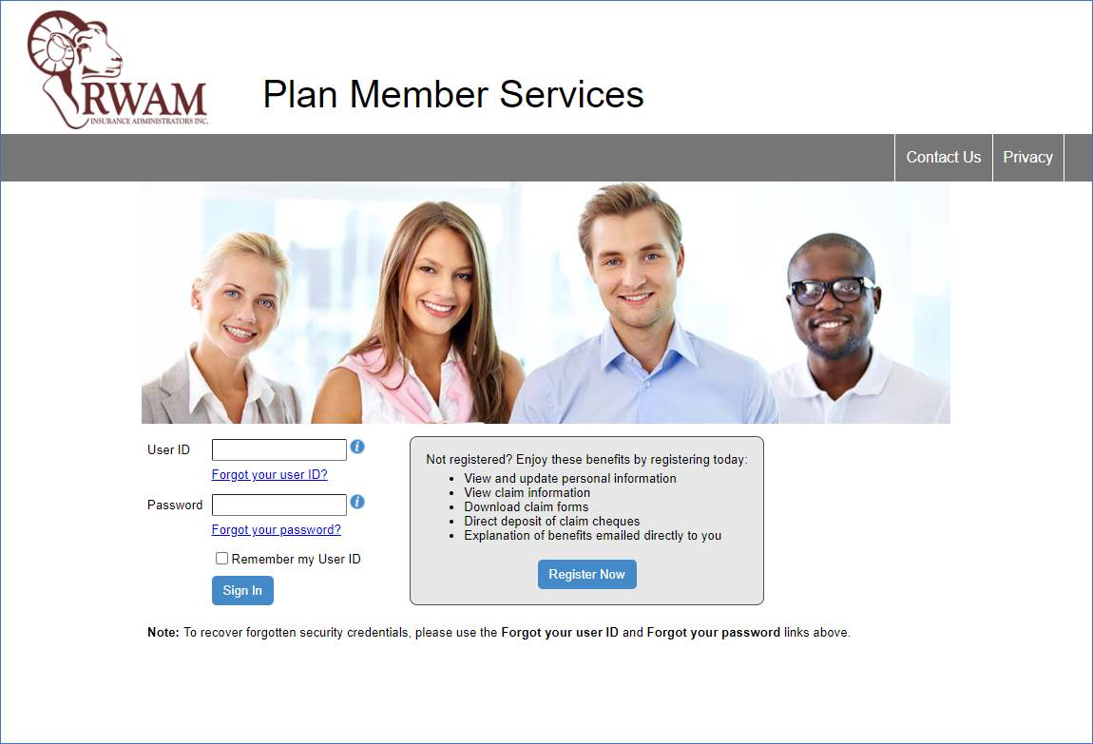
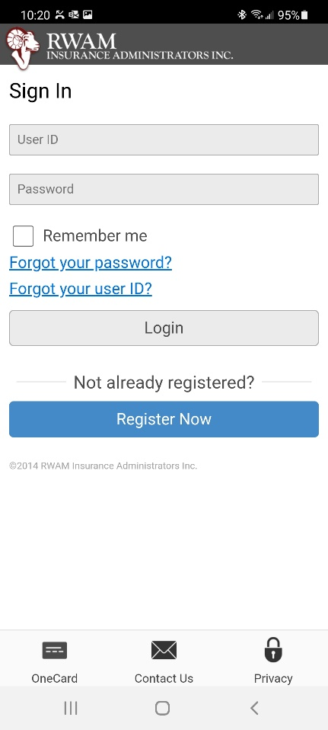
It’s easy to register online for RWAM’s Plan Member Services!
The first time you visit Plan Member Services or the RWAM Mobile App - click “Register Now” to start registration for your new benefits plan.
Did You Know?
You can utilize the RWAM Mobile App to give you even more freedom to access select features of your Plan Member Services account whenever and however it is most convenient for you!

Slide 4
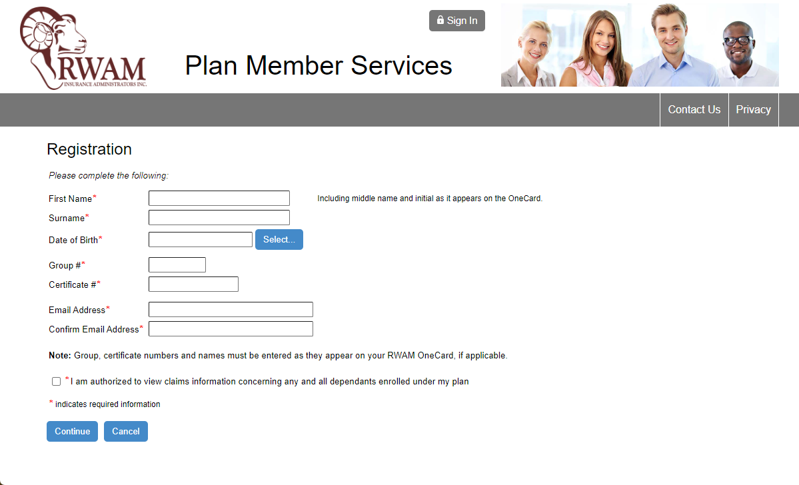
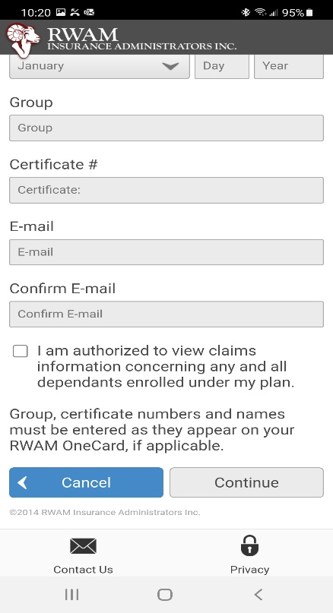
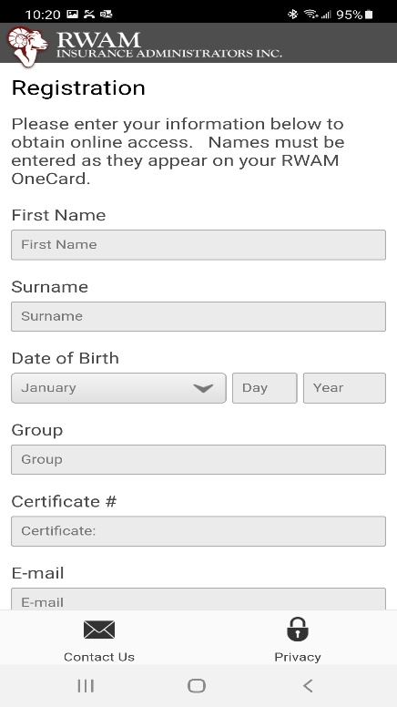
Complete your registration

Slide 5
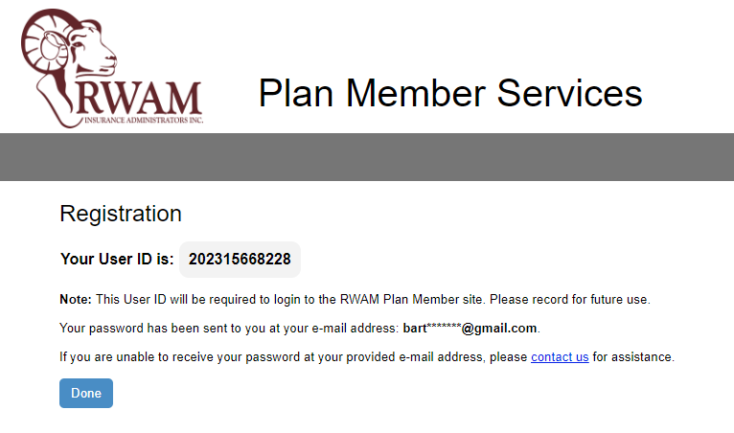
User ID and Password
After you click “Continue” a 12-digit User ID will appear on screen.
Ask to have the temporary password emailed to you.
Note: You will use your User ID every time you sign in, so ensure you record it somewhere safe and secure for future reference.

Slide 6
Login to your account!
Copy the password you receive in your email from RWAM and return to the Plan Member Services website. Paste your User ID and temporary password into their respective fields and click “Sign In”.
Note: Once you’ve logged in, you will be prompted to change the temporary password. Follow the criteria and ensure you securely save your new password for future reference.

Slide 7
Welcome to your account!
NOW THAT YOU ARE REGISTERED AND LOGGED IN, YOU CAN:
Submit your health and dental claims electronically.
Access your processed claims and Explanation of Benefits statements.
Review your coverage details
Manage your direct deposit and banking information
View and print your RWAM OneCard
View and print statements for Coordination of Benefits or Income Tax purposes
Review your Employee Benefits Booklet
Review your dependent details

Slide 8
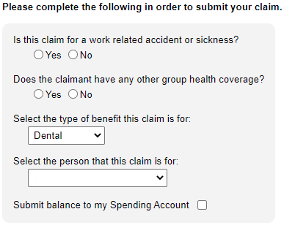
Submitting a claim on RWAM’s Plan Member Services website is as easy as 1 2 3!
1
Review and if necessary, update your direct deposit information.
Select the claim type and individual the claim is for.
Attach all necessary receipts and documentation that RWAM will require, and Submit!
2
3
It’s that easy!

Slide 9
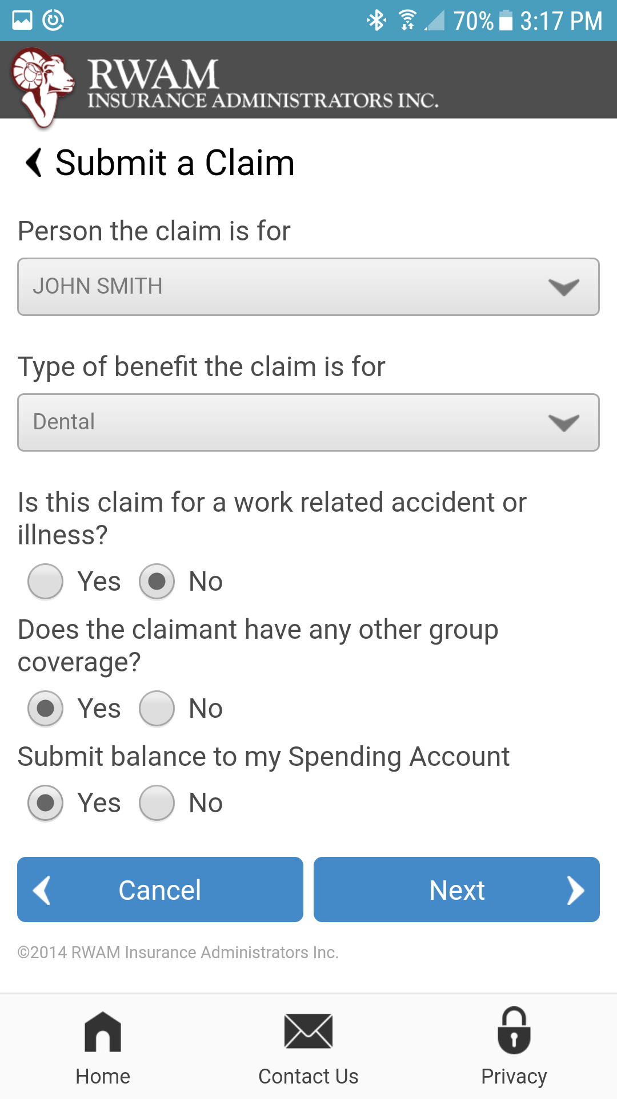
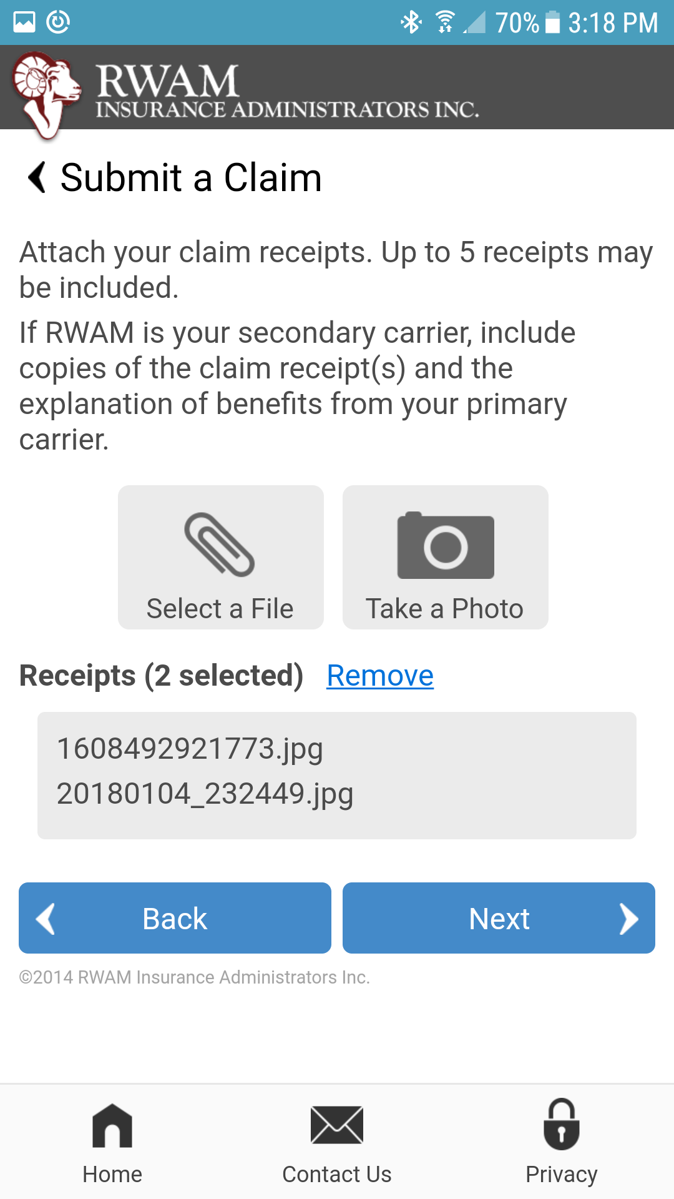
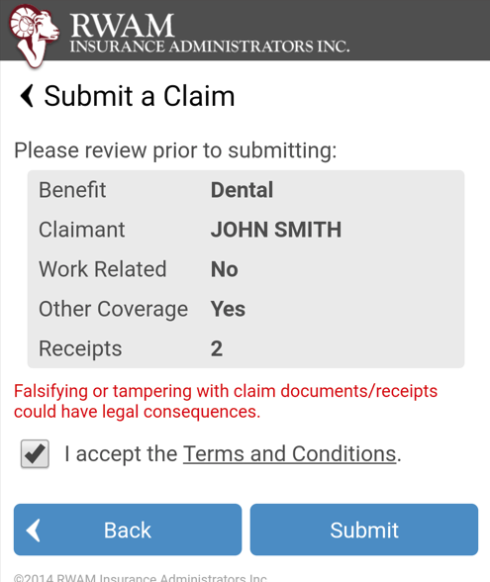
Submitting a claim through the Mobile App is as easy as 1 2 3!
Review and if necessary, update your direct deposit information.
Select the claim type and individual the claim is for.
Take a picture of all necessary receipts and documentation that RWAM will require, and Submit!
It’s that easy!

Slide 10
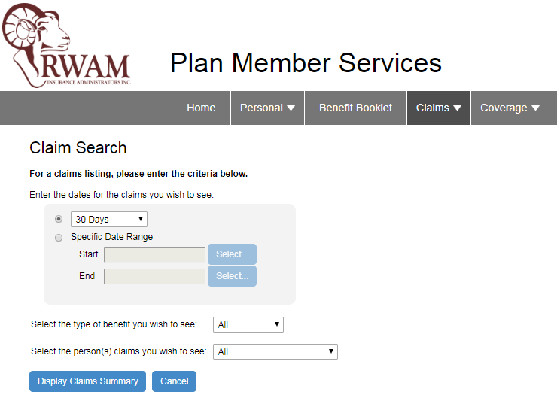
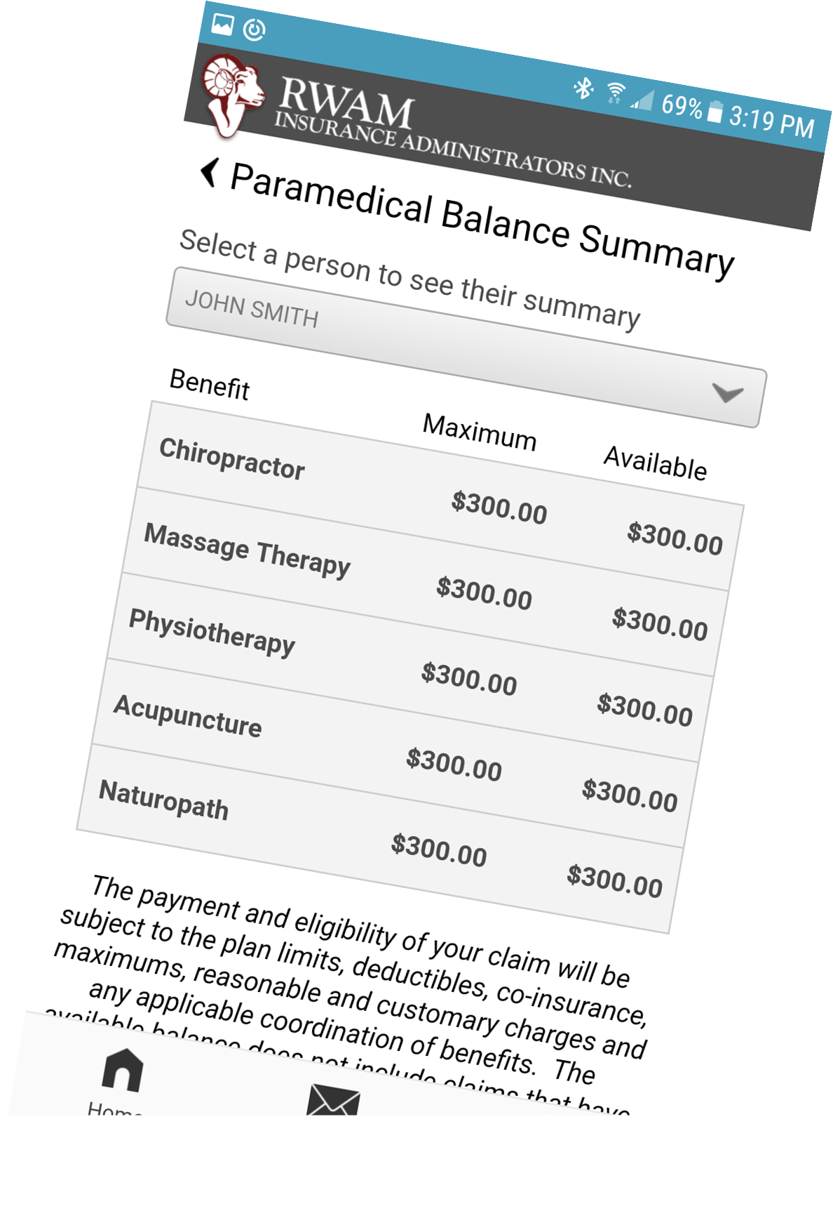
Claims Search and Benefit Summary
On the Plan Member Services website, you can find and search any pending claims and claim history for you and your dependents.
You can also view a current paramedical balance summary.
Did You Know?
RWAM Customer Service Representatives are available to help you with any questions you might have with your group benefits plan. Call us at 1.877.888.7926 or email us, our team is here to help.

Slide 11
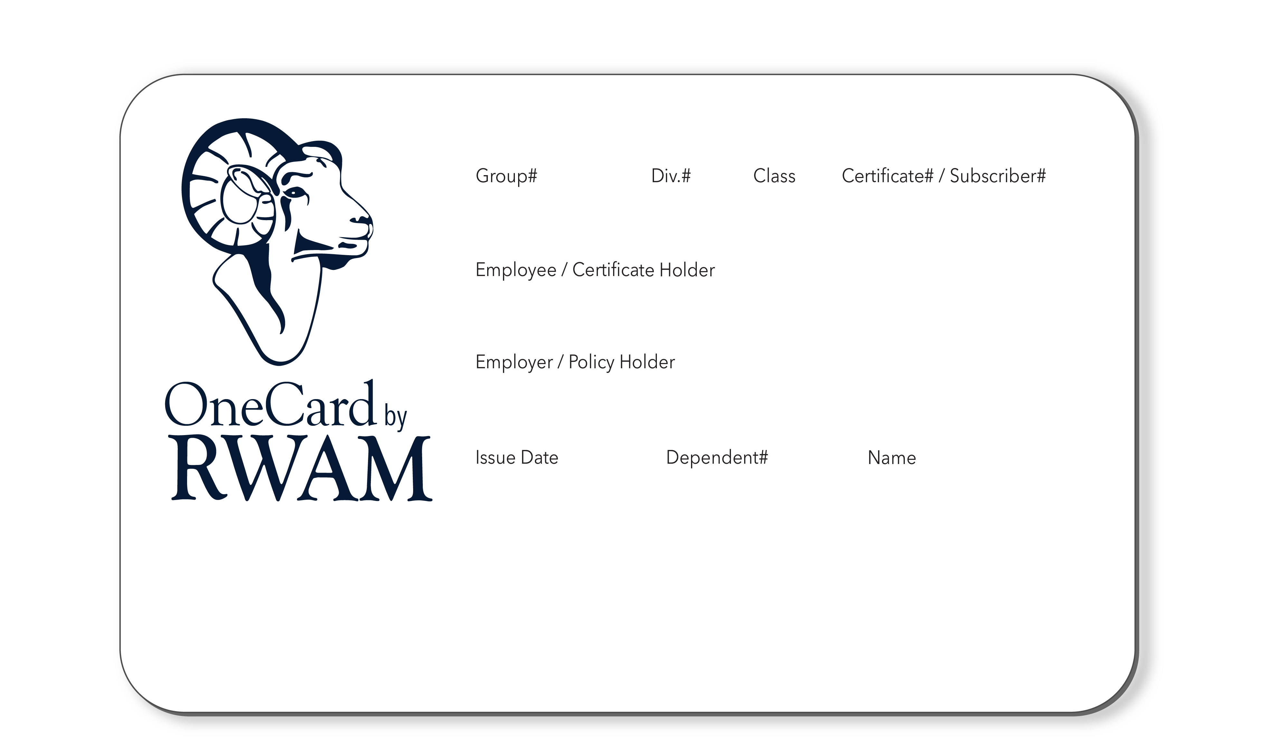
Your RWAM OneCard
The RWAM OneCard offers the convenience of a single card used as your:
Drug Card
Hospital Card*
Dental Card*
Out-of-Province/Out-of-Canada Travel Card*
Paramedical Claims Card for paramedical claims submitted directly by your Provider*
* If applicable to your group plan
Did You Know?
If you damage, lose or misplace your RWAM OneCard and need a replacement or quick access, you can find your RWAM OneCard online or on the Mobile App!

Slide 12
Don’t pay out of pocket for paramedical services!
RWAM makes it easy for your practitioner to submit paramedical and vision claims on your behalf. Providers can submit claims online through TELUS for real-time adjudication and your claim payments are conveniently and immediately directed to your healthcare provider.
THE FOLLOWING PROVIDERS MAY BE ABLE TO SUBMIT CLAIMS DIRECTLY TO RWAM ON YOUR BEHALF:
Physiotherapist
Massage Therapist
Acupuncturist
Chiropractor
Naturopath
Podiatrist
Chiropodist
Speech Therapist
Osteopath*
Optical providers
Psychologist
Psychotherapist*
Social Worker* (MSW)
*These providers are only eligible via the RWAM Provider Claims Services portal – for more information visit RWAM Provider FAQ’s

